Slide 1
Data Structures and Algorithms
LECTURE 01: ABSTRACT DATA TYPE

Slide 2
Overview:
1. What is Data Abstraction? What is ADT?
2. Model for an Abstract Data Type
3. ADT Example
4. ADT vs Object-Oriented Programming

Slide 3
What is Data Abstraction?
Concept of “Abstraction”
Allows us to consider the high-level characteristics of something without getting bogged down in the details
For example: Method abstraction in OOP like C++, we can use (pre-defined) methods without concern how they really works inside.
Data Abstraction
We know what a data type can do
How it is done is hidden

Slide 4
What is an Abstract Data Type?
Abstract Data Type (ADT)
Defines a particular data structure in terms of data and operations
Offers an interface of the objects (instances of an ADT)
An ADT consists of
Declaration of data
Declaration of operations
Encapsulation of data and operations : data is hidden from user and can be manipulated only by means of operations

Slide 5
ADT example: Floating point numbers
You don't need to know how much about floating point arithmetic works to use float
Indeed, the details can vary depending on processor, even virtual coprocessor
But the compiler hides all the details from you--some numeric ADTs are built-in
All you need to know is the syntax and meaning of operators, +, -, *, /, etc.
Hiding the details of implementation is called encapsulation (data hiding)

Slide 6
ADT = properties + operations
An ADT describes a set of objects sharing the same properties and behaviors
The properties of an ADT are its data (representing the internal state of each object
double d; -- bits representing exponent & mantissa are its data or state
The behaviors of an ADT are its operations or functions (operations on each instance)
sqrt(d) / 2; //operators & functions are its behaviors
Thus, an ADT couples its data and operations
OOP emphasizes data abstraction

Slide 7
Formal, language-independent ADTs
An ADT is a formal description, not code; independent of any programming language
Why is code independence a good idea?
Promotes design by contract:
Specify responsibilities of suppliers and clients explicitly, so they can be enforced, if necessary

Slide 8
ADT Implementation
Implementaion of an Abstract Data Type (ADT)
Hidden from the user
Same ADT may be implemented in different ways in different languages
Some languages offer built-in ADTs and/or features to be used to implement ADTs (user-define types)
ADTs support modular design which is very important in software development

Slide 9
ADT from definition to implementation
System design with ADTs
Identification of ADTs
(identify data or attributes)
Problem definiton
Specify ADT interactions
Specify ADT operations
Identify object hierarchy (if using OOP)
Implement ADTs

Slide 10
Benefits
Manufacturer (who creates ADT) benefits:
easy to modify, maintain
profitable
reusable
Client (who uses ADT) benefits:
simple to use, understand
familiar
cheap
component–based

Slide 11
ADT example: LIST ADT
A list contains elements of same type arranged in sequential order and following operations can be performed on the list.
get() – Return an element from the list at any given position.
insert() – Insert an element at any position of the list.
remove() – Remove the first occurrence of any element from a non-empty list.
removeAt() – Remove the element at a specified location from a non-empty list.
replace() – Replace an element at any position by another element.
size() – Return the number of elements in the list.
isEmpty() – Return true if the list is empty, otherwise return false.
isFull() – Return true if the list is full, otherwise return false.

Slide 12
VDM Specification Language
The Vienna Development Method (VDM) was originally developed at the IBM laboratories in Vienna in the 1970’
A formal specification language intended to specify object oriented systems
ADT can be specified by a formal language likes VDM

Slide 13
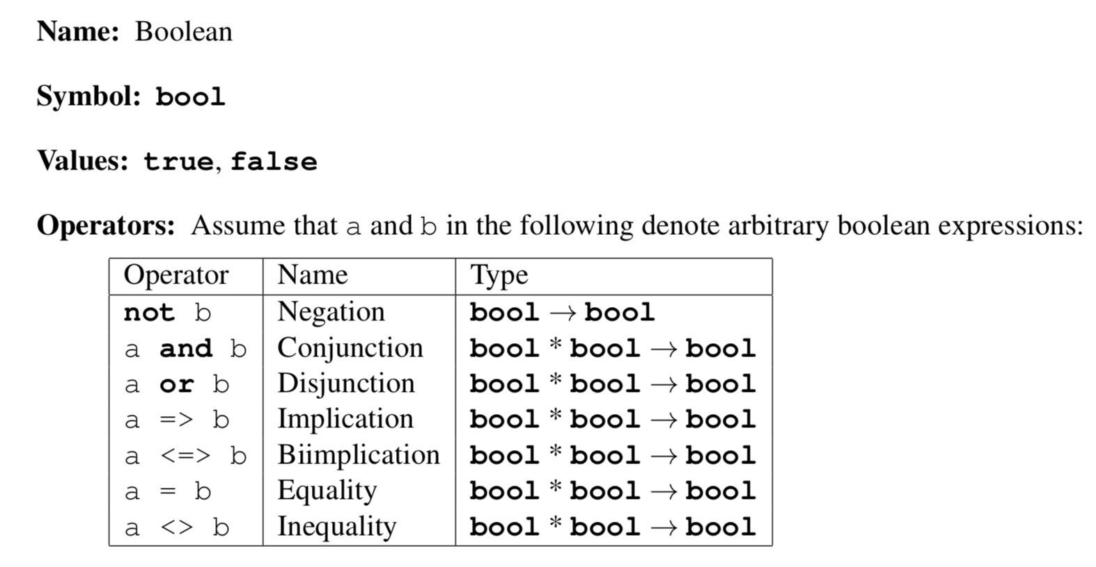
ADT in VDM example: Boolean type

Slide 14
ADT vs Object-Oriented Programming (OOP)
ADTs are not a part of a particular programming language
Rather they are implemented by a programmer to solve a particular problem or some class of problems
In OOP, an ADT can be easily modeled as a class
An instance as an object
Data of ADT as properties or fields of a class
Operations as methods
ADT ≠ OOP
Classes in OOP offers more features than ADTs : Inheritance (Superclass-Subclass), Polymorphisms, etc.

Slide 15
The end

